Slide 1
Chapter 3 – Agile Software Development

Slide 2
Topics covered
Agile methods
Agile development techniques
Agile project management
Scaling agile methods

Slide 3
Agile
In 2001, Kent Beck and 16 other noted software developers, writers, and consultants [Bec01a] (referred to as the “Agile Alliance”) signed the “Manifesto for Agile Software Development.” It stated:
We are uncovering better ways of developing software by doing it and helping others do it. Through this work we have come to value:
Individuals and interactions over processes and tools
Working software over comprehensive documentation
Customer collaboration over contract negotiation
Responding to change over following a plan
That is, while there is value in the items on the right, we value the items on the left more.

Slide 4
Rapid software development
Rapid development and delivery is now often the most important requirement for software systems
Businesses operate in a fast –changing requirement and it is practically impossible to produce a set of stable software requirements
Software has to evolve quickly to reflect changing business needs.
Plan-driven development is essential for some types of system but does not meet these business needs.
Agile development methods emerged in the late 1990s whose aim was to radically reduce the delivery time for working software systems

Slide 5

Rapid software development (Agile)
Rapid software development
Specification, design and implementation are inter-leaved
System is developed as a series of versions with stakeholders involved in version evaluation
User interfaces are often developed using an IDE and graphical toolset.
Development
Analysis and Quick Design
Testing
Implementation
Build
Refine
Iterations

Slide 6
Plan-driven and agile development
Plan-driven development
A plan-driven approach to software engineering is based around separate development stages with the outputs to be produced at each of these stages planned in advance.
Not necessarily waterfall model – plan-driven, incremental development is possible
Iteration occurs within activities.
Agile development
Specification, design, implementation and testing are inter-leaved and the outputs from the development process are decided through a process of negotiation during the software development process.

Slide 7



Plan-driven vs. Agile methods
Continuum
Very agile
Very controlled
Communication and control
predictive
Informal information communication
adaptive
Extremes
Generalities

Slide 8
Plan-driven vs. Agile methods
Approach
Plan-driven
Coded deliverables
Agile method
Artifact, milestone
Up-front planning
Structured communication
Well-defined roles
On-going planning
Limited change control
Lower project ceremony

Slide 9
Plan-driven and agile development

Slide 10
Agile methods

Slide 11



Agile methods
Dissatisfaction with legacy methods of 1980s, 1990 led to agile methods
Aim: To reduce overheads in software process
Extensive rework
Specialist
Agile Methods Focus
Code rather than
design
2. Iterative
3. Evolution
Team lead
Team member
Integrator
Experts
Development team
Stakeholder
Domain expert
Architecture. expert
Owner

Slide 12
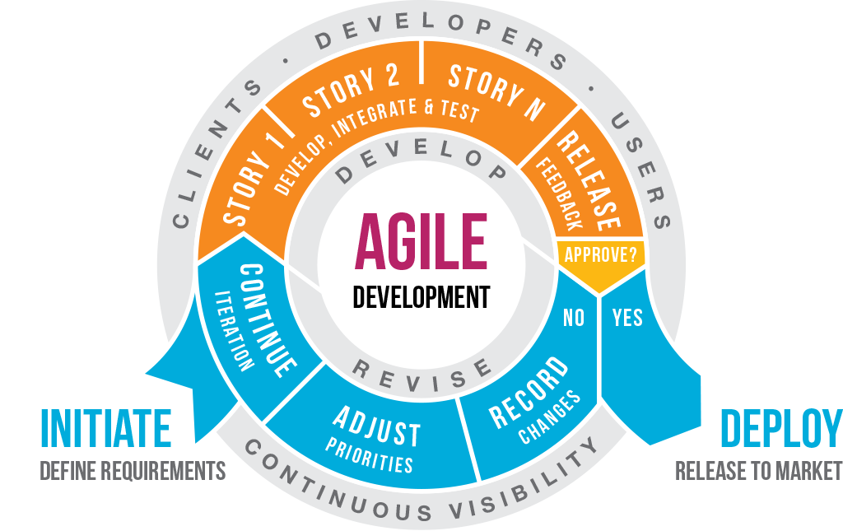
Agile methods

Slide 13

Agile manifesto
Agile method preferences
Agile Methods
Legacy Methods
Individual and interaction
Process and tools
Working software
Comprehensive documents
Customer collaboration
Contract negotiation
Responding to change
Following a plan

Slide 14


Principles of agile methods
Agility
Customer involvement
Incremental delivery
People not process
Embrace change
Maintain simplicity
Continued Improvement

Slide 15
The principles of agile methods
Principle | Description
Customer involvement | Customers should be closely involved throughout the development process. Their role is provide and prioritize new system requirements and to evaluate the iterations of the system.
Incremental delivery | The software is developed in increments with the customer specifying the requirements to be included in each increment.
People not process | The skills of the development team should be recognized and exploited. Team members should be left to develop their own ways of working without prescriptive processes.
Embrace change | Expect the system requirements to change and so design the system to accommodate these changes.
Maintain simplicity | Focus on simplicity in both the software being developed and in the development process. Wherever possible, actively work to eliminate complexity from the system.

Slide 16

Agile method applicability
Agile methods can be:
People-centric: way to create innovative solutions
Product-centric: alternative to documents/process
Market-centric: model to maximize business value
Product development
Small size software
Medium size software
Custom system development
Customer fully involved in the development process
Not a lot of external rules and regulations
Two types of development with Agile Methods:
http://semanticommunity.info/AOL_Government/ACT-IAC_Agile_Development

Slide 17
Agile Alliance’s Twelve Agility Principles
Our highest priority is to satisfy the customer through early and continuous delivery of valuable software.
Welcome changing requirements, even late in development. Agile processes harness change for the customer’s competitive advantage.
Deliver working software frequently, from a couple of weeks to a couple of months, with a preference to the shorter timescale.
Business people and developers must work together daily throughout the project.
Build projects around motivated individuals. Give them the environment and support they need, and trust them to get the job done.

Slide 18
Agile Alliance’s Twelve Agility Principles
The most efficient and effective method of conveying information to and within a development team is face-to-face conversation.
Working software is the primary measure of progress.
Agile processes promote sustainable development. The sponsors, developers, and users should be able to maintain a constant pace indefinitely.
Continuous attention to technical excellence and good design enhances agility.
Simplicity—the art of maximizing the amount of work not done—is essential.
The best architectures, requirements, and designs emerge from self–organizing teams.
At regular intervals, the team reflects on how to become more effective, then tunes and adjusts its behavior accordingly.

Slide 19


Problems with agile methods
Difficulty in keeping the interest of involved customers
Unsuited team members with characteristics of agility
Multiple stakeholders(difficulty in prioritizing updates)
Simplicity costs extra work
Contracts may be a problem

Slide 20
Technical, human, organizational issues
Most projects include elements of plan-driven and agile processes. Deciding on the balance depends on:
Is it important to have a very detailed specification and design before moving to implementation? If so, you probably need to use a plan-driven approach.
Is an incremental delivery strategy, where you deliver the software to customers and get rapid feedback from them, realistic? If so, consider using agile methods.
How large is the system that is being developed? Agile methods are most effective when the system can be developed with a small co-located team who can communicate informally. This may not be possible for large systems that require larger development teams so a plan-driven approach may have to be used.

Slide 21
Technical, human, organizational issues
Issues
What type of system is being developed?
Plan-driven approaches may be required for systems that require a lot of analysis before implementation
What is expected lifetime of the system?
Long-lifetime systems require more design documentation to communicate the original intentions of the system developers to the support team
What technologies are available and how is team organized?
Agile methods rely on good tools.
If the development team is distributed or if part of the development is being outsourced

Slide 22
Technical, human, organizational issues
Issues
Are there cultural or organizational issues that may affect the system development?
Traditional engineering organizations have a culture of plan-based development, as this is the norm in engineering
How good are the designers and programmers in the development team?
It is sometimes argued that agile methods require higher skill levels than plan-based approaches in which programmers simply translate a detailed design into code.
Is the system subject to external regulation?
If a system has to be approved by an external regulator (e.g. the FAA approve software that is critical to the operation of an aircraft) then you will probably be required to produce detailed documentation as part of the system safety case.

Slide 23
Agile development techniques

Slide 24
“It’s programming if `clever` is a compliment, but it’s software engineering if `clever` is an accusation.”

Slide 25
Agile Methods in this lecture
Agile Methods
Extreme Programming
Scrum

Slide 26

Extreme programming
Perhaps the best-known and most widely used agile method
Release plan
months
Iteration plan
weeks
Acceptance test
days
Pair negotiation
hours
Unit test
minutes
Pair programming
seconds
Code
Ref: http://petercodes.wordpress.com/2013/11/09/personal-extreme-programming-part-2-why-agile-and-why-xp/

Slide 27
XP and agile principles
Incremental development is supported through small, frequent system releases.
Customer involvement means full-time customer engagement with the team.
People not process through pair programming.
Change supported through regular system releases.
Maintaining simplicity through constant refactoring of code.

Slide 28
XP (Test First Programming)
Instead of following the normal path of:
develop code -> write tests -> run tests
The practice of Test-First Programming follows the path of:
Write failing automated test -> Run failing test -> develop code to make test pass -> run test -> repeat
As with Continuous Integration, Test-First Programming reduces the feedback cycle for developers to identify and resolve issues, thereby decreasing the number of bugs that get introduced into production.

Slide 29
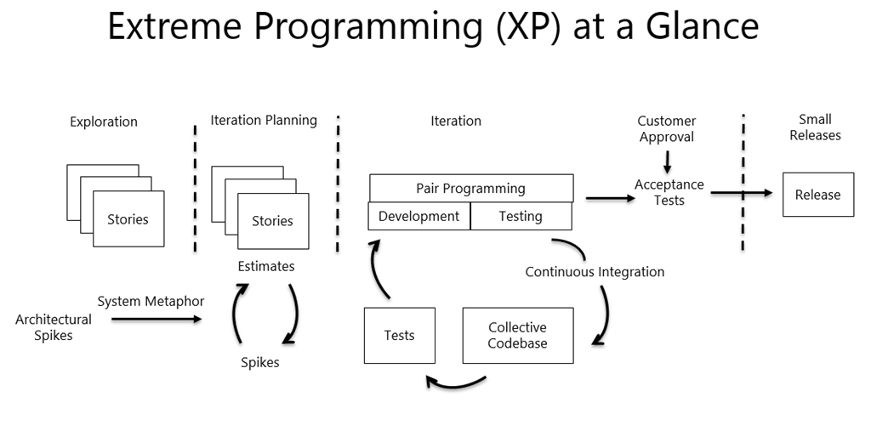
XP

Slide 30
XP release cycle
Select user stories for this release
Break down stories to tasks
Plan release
Evaluate system
Release software
Develop/Integrate/test software

Slide 31
Extreme programming practices
Small releases
Metaphor
Sustainable pace
Cont. integration
Pair programming
Test-driven
Planning
Customer tests
Simple design
Refactoring
Coding standard
Collective ownership
Whole team
Ref: http://xprogramming.com/what-is-extreme-programming/

Slide 32
Extreme programming practices (a) Detailed
Principle or practice | Description
Incremental planning | Requirements are recorded on story cards and the stories to be included in a release are determined by the time available and their relative priority. The developers break these stories into development ‘Tasks’. See Figures 3.5 and 3.6.
Small releases | The minimal useful set of functionality that provides business value is developed first. Releases of the system are frequent and incrementally add functionality to the first release.
Simple design | Enough design is carried out to meet the current requirements and no more.
Test-first development | An automated unit test framework is used to write tests for a new piece of functionality before that functionality itself is implemented.
Refactoring | All developers are expected to refactor the code continuously as soon as possible code improvements are found. This keeps the code simple and maintainable.

Slide 33
Extreme programming practices (b) Detailed
Pair programming | Developers work in pairs, checking each other’s work and providing the support to always do a good job.
Collective ownership | The pairs of developers work on all areas of the system, so that no islands of expertise develop and all the developers take responsibility for all of the code. Anyone can change anything.
Continuous integration | As soon as the work on a task is complete, it is integrated into the whole system. After any such integration, all the unit tests in the system must pass.
Sustainable pace | Large amounts of overtime are not considered acceptable as the net effect is often to reduce code quality and medium term productivity
On-site customer | A representative of the end-user of the system (the customer) should be available full time for the use of the XP team. In an extreme programming process, the customer is a member of the development team and is responsible for bringing system requirements to the team for implementation.

Slide 34
User stories for requirements
In XP, a customer or user is part of the XP team and is responsible for making decisions on requirements.
User requirements are expressed as user stories or scenarios.
These are written on cards and the development team break them down into implementation tasks. These tasks are the basis of schedule and cost estimates.
The customer chooses the stories for inclusion in the next release based on their priorities and the schedule estimates.

Slide 35
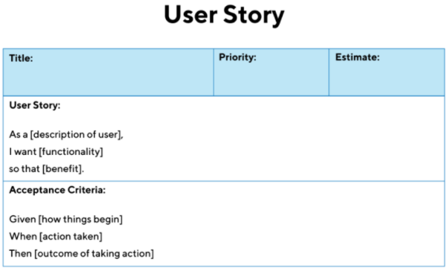
As a driver, I want to block badly behaved passengers so they are never shown me again.

Slide 36
A ‘prescribing medication’ story

Slide 37
Examples of task cards for prescribing medication

Slide 38

Refactoring

Slide 39

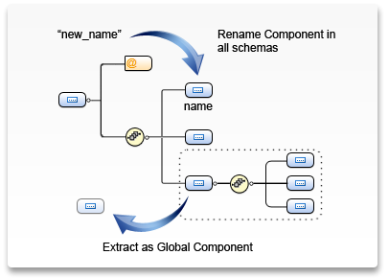

Refactoring
What is Refactoring?
Changing the structure of the code without changing its behavior for better understanding
Example refactoring
Rename
Extract method/interface
Inline
Pull up/Push down
Ref: http://www.oxygenxml.com/img/mb_dev_schema_refactoring.png

Slide 40
Refactoring
Programming team look for possible software improvements and make these improvements even where there is no immediate need for them.
This improves the understandability of the software and so reduces the need for documentation.
Changes are easier to make because the code is well-structured and clear.
However, some changes requires architecture refactoring and this is much more expensive.

Slide 41
Examples of refactoring
Re-organization of a class hierarchy to remove duplicate code.
Tidying up and renaming attributes and methods to make them easier to understand.
The replacement of inline code with calls to methods that have been included in a program library.

Slide 42
Test-first development
Test-driven development
Customer involvement
Test automation

Slide 43
Test case description for dose checking

Slide 44
XP testing difficulties
Programmers prefer programming
Taking short cuts when writing tests
Writing incomplete tests that do not check for all possible exceptions that may occur.
Difficult to write test that work incrementally
For example unit tests for the code that implements the ‘display logic’ and workflow between screens.
It is difficult to judge the completeness of a set of tests.

Slide 45
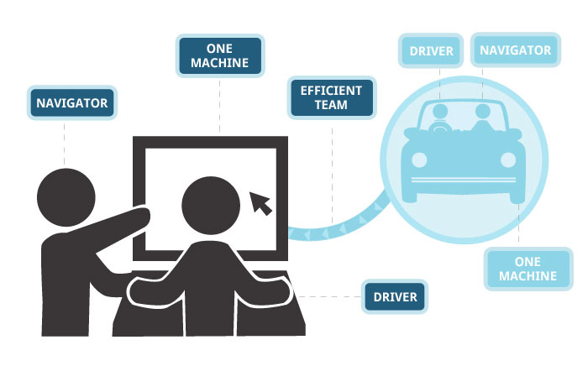
Pair Programming

Slide 46

Pair programming
Two people working together at a single computer.
2 people working at a single computer will add as much functionality as two working separately except that it will be much higher in quality.
A review process
My experience
Collective experience
Your experience

Slide 47
Pair programming
In pair programming, programmers sit together at the same workstation to develop the software.
Pairs are created dynamically so that all team members work with each other during the development process.
The sharing of knowledge that happens during pair programming is very important as it reduces the overall risks to a project when team members leave.
Pair programming is not necessarily inefficient and there is evidence that a pair working together is more efficient than 2 programmers working separately.

Slide 48
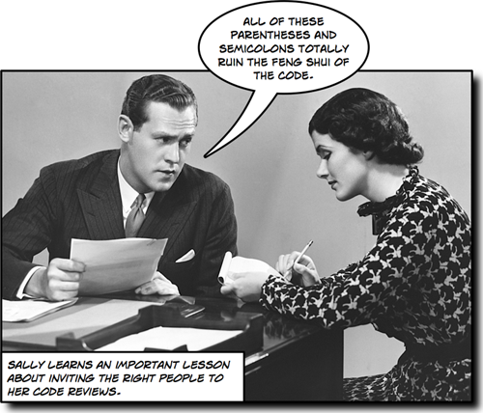



Advantages of pair programming
Review
Idea sharing
Responsibility
Dynamicity

Slide 49
Agile project management

Slide 50

Scrum

Slide 51

Agile project management (SCRUM)
The Scrum approach is a general agile method but its focus is on managing iterative development rather than specific agile practices
Continuous review
Feedback
Items
Planning
Collaboration
Delivery
Ref: http://en.wikipedia.org/wiki/Project_management

Slide 52

The Scrum process
The Scrum approach is a general agile method but its focus is on managing iterative development rather than specific agile practices.
Three phases
Scrum master
Review
Develop
Adjust
Select
Planning and architecture
Sprints
Closure

Slide 53
The Scrum Process: Explained
Planning and architecture:
Sprint cycles:
Closure:
Establishing objectives and design architecture
Each sprint develops an increment of system
Wrap up of project, documentation, such as manuals and lessons learned completion

Slide 54
Sprint cycle
Length
Normally 2-4 weeks
Corresponds to a release development of XP
Adjust
Start point: backlog of product
Backlog is a list of work to be done
Select
Involves project team to select features etc.
Develop functionality
Review
Reviewed and shown to stakeholders
Next cycle begins
Master
Manage all communication
Protect from external distraction

Slide 55

Teamwork in Scrum
Scrum master
Works as facilitator
Arranges meetings
Team members
Attends meetings
Discuss problems
Tracks backlog
And manages communication with outer world
Describe progress
Next plan
Team work

Slide 56

Scrum benefits
Product divided into chunks
manageable
Understandable
Communication
Visible to everyone
Improved communication
delivery
On-time
Feedback
Requirements does not hold progress
Trust and project success

Slide 57
Scrum terminology (a)
Scrum term | Definition
Development team | A self-organizing group of software developers, which should be no more than 7 people. They are responsible for developing the software and other essential project documents.
Potentially shippable product increment | The software increment that is delivered from a sprint. The idea is that this should be ‘potentially shippable’ which means that it is in a finished state and no further work, such as testing, is needed to incorporate it into the final product. In practice, this is not always achievable.
Product backlog | This is a list of ‘to do’ items which the Scrum team must tackle. They may be feature definitions for the software, software requirements, user stories or descriptions of supplementary tasks that are needed, such as architecture definition or user documentation.
Product owner | An individual (or possibly a small group) whose job is to identify product features or requirements, prioritize these for development and continuously review the product backlog to ensure that the project continues to meet critical business needs. The Product Owner can be a customer but might also be a product manager in a software company or other stakeholder representative.

Slide 58
Scrum terminology (b)
Scrum term | Definition
Scrum | A daily meeting of the Scrum team that reviews progress and prioritizes work to be done that day. Ideally, this should be a short face-to-face meeting that includes the whole team.
ScrumMaster | The ScrumMaster is responsible for ensuring that the Scrum process is followed and guides the team in the effective use of Scrum. He or she is responsible for interfacing with the rest of the company and for ensuring that the Scrum team is not diverted by outside interference. The Scrum developers are adamant that the ScrumMaster should not be thought of as a project manager. Others, however, may not always find it easy to see the difference.
Sprint | A development iteration. Sprints are usually 2-4 weeks long.
Velocity | An estimate of how much product backlog effort that a team can cover in a single sprint. Understanding a team’s velocity helps them estimate what can be covered in a sprint and provides a basis for measuring improving performance.

Slide 59
Scrum sprint cycle

Slide 60
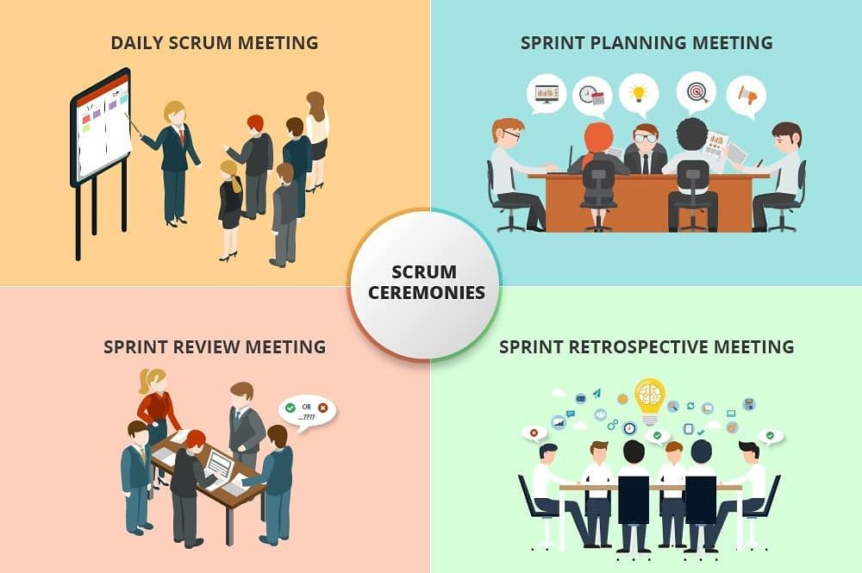

Slide 61
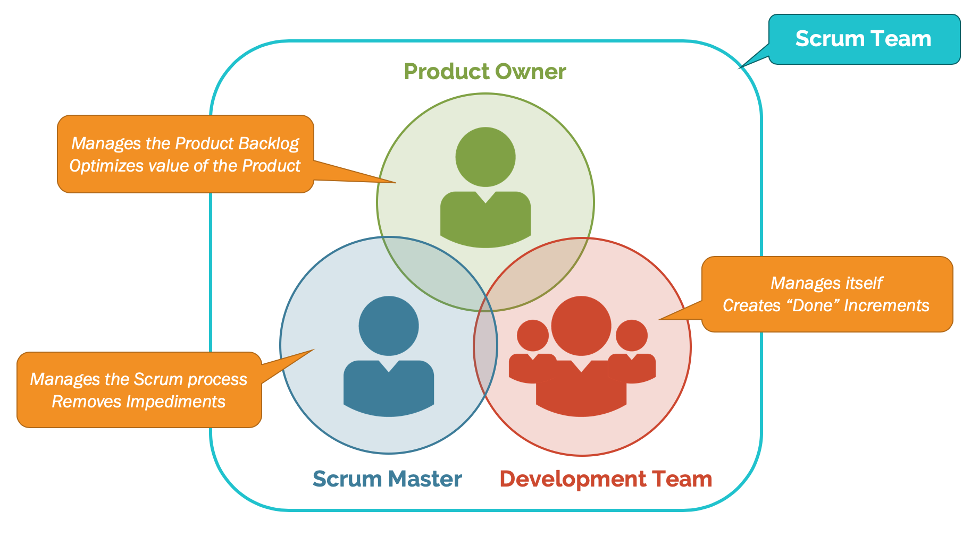

Slide 62
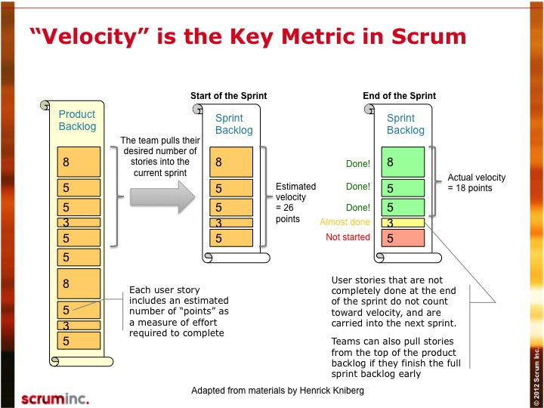

Slide 63
Distributed Scrum

Slide 64
Scaling agile methods

Slide 65
Scaling agile methods
Agile methods have proved to be successful for small and medium sized projects that can be developed by a small co-located team.
It is sometimes argued that the success of these methods comes because of improved communications which is possible when everyone is working together.
Scaling up agile methods involves changing these to cope with larger, longer projects where there are multiple development teams, perhaps working in different locations.

Slide 66
Scaling out and scaling up
‘Scaling up’ is concerned with using agile methods for developing large software systems that cannot be developed by a small team.
‘Scaling out’ is concerned with how agile methods can be introduced across a large organization with many years of software development experience.
When scaling agile methods it is important to maintain agile fundamentals:
Flexible planning, frequent system releases, continuous integration, test-driven development and good team communications.

Slide 67
Practical problems with agile methods
The informality of agile development is incompatible with the legal approach to contract definition that is commonly used in large companies.
Agile methods are most appropriate for new software development rather than software maintenance. Yet the majority of software costs in large companies come from maintaining their existing software systems.
Agile methods are designed for small co-located teams yet much software development now involves worldwide distributed teams.

Slide 68
Contractual issues
Most software contracts for custom systems are based around a specification, which sets out what has to be implemented by the system developer for the system customer.
However, this precludes interleaving specification and development as is the norm in agile development.
A contract that pays for developer time rather than functionality is required.
However, this is seen as a high risk my many legal departments because what has to be delivered cannot be guaranteed.

Slide 69
Agile methods and software maintenance
Most organizations spend more on maintaining existing software than they do on new software development. So, if agile methods are to be successful, they have to support maintenance as well as original development.
Two key issues:
Are systems that are developed using an agile approach maintainable, given the emphasis in the development process of minimizing formal documentation?
Can agile methods be used effectively for evolving a system in response to customer change requests?
Problems may arise if original development team cannot be maintained.

Slide 70
Agile maintenance
Key problems are:
Lack of product documentation
Keeping customers involved in the development process
Maintaining the continuity of the development team
Agile development relies on the development team knowing and understanding what has to be done.
For long-lifetime systems, this is a real problem as the original developers will not always work on the system.

Slide 71
Formal documentation is supposed to describe the system and so make it easier for people changing the system to understand. In practice, however, formal documentation is rarely updated and so does not accurately reflect the program code. For this reason, agile methods enthusiasts argue that it is a waste of time to write this documentation and that the key to implementing maintainable software is to produce high-quality, readable code. The lack of documentation should not be a problem in maintaining systems developed using an agile approach.

Slide 72
Agile and plan-based factors

Slide 73
System issues
How large is the system being developed?
Agile methods are most effective a relatively small co-located team who can communicate informally.
What type of system is being developed?
Systems that require a lot of analysis before implementation need a fairly detailed design to carry out this analysis.
What is the expected system lifetime?
Long-lifetime systems require documentation to communicate the intentions of the system developers to the support team.
Is the system subject to external regulation?
If a system is regulated you will probably be required to produce detailed documentation as part of the system safety case.

Slide 74
People and teams
How good are the designers and programmers in the development team?
It is sometimes argued that agile methods require higher skill levels than plan-based approaches in which programmers simply translate a detailed design into code.
How is the development team organized?
Design documents may be required if the team is dsitributed.
What support technologies are available?
IDE support for visualisation and program analysis is essential if design documentation is not available.

Slide 75
Organizational issues
Traditional engineering organizations have a culture of plan-based development, as this is the norm in engineering.
Is it standard organizational practice to develop a detailed system specification?
Will customer representatives be available to provide feedback of system increments?
Can informal agile development fit into the organizational culture of detailed documentation?

Slide 76
Agile methods for large systems
Large systems are usually collections of separate, communicating systems, where separate teams develop each system. Frequently, these teams are working in different places, sometimes in different time zones.
Large systems are ‘brownfield systems’, that is they include and interact with a number of existing systems. Many of the system requirements are concerned with this interaction and so don’t really lend themselves to flexibility and incremental development.
Where several systems are integrated to create a system, a significant fraction of the development is concerned with system configuration rather than original code development.

Slide 77
Large system development
Large systems and their development processes are often constrained by external rules and regulations limiting the way that they can be developed.
Large systems have a long procurement and development time. It is difficult to maintain coherent teams who know about the system over that period as, inevitably, people move on to other jobs and projects.
Large systems usually have a diverse set of stakeholders. It is practically impossible to involve all of these different stakeholders in the development process.

Slide 78
Factors in large systems

Slide 79
IBM’s agility at scale model

Slide 80
Scaling up to large systems
A completely incremental approach to requirements engineering is impossible.
There cannot be a single product owner or customer representative.
For large systems development, it is not possible to focus only on the code of the system.
Cross-team communication mechanisms have to be designed and used.
Continuous integration is practically impossible. However, it is essential to maintain frequent system builds and regular releases of the system.

Slide 81
Multi-team Scrum
Role replication
Each team has a Product Owner for their work component and ScrumMaster.
Product architects
Each team chooses a product architect and these architects collaborate to design and evolve the overall system architecture.
Release alignment
The dates of product releases from each team are aligned so that a demonstrable and complete system is produced.
Scrum of Scrums
There is a daily Scrum of Scrums where representatives from each team meet to discuss progressand plan work to be done.

Slide 82
Agile methods across organizations
Project managers who do not have experience of agile methods may be reluctant to accept the risk of a new approach.
Large organizations often have quality procedures and standards that all projects are expected to follow and, because of their bureaucratic nature, these are likely to be incompatible with agile methods.
Agile methods seem to work best when team members have a relatively high skill level. However, within large organizations, there are likely to be a wide range of skills and abilities.
There may be cultural resistance to agile methods, especially in those organizations that have a long history of using conventional systems engineering processes.

Slide 83
Key points
Agile methods are incremental development methods that focus on rapid software development, frequent releases of the software, reducing process overheads by minimizing documentation and producing high-quality code.
Agile development practices include
User stories for system specification
Frequent releases of the software,
Continuous software improvement
Test-first development
Customer participation in the development team.

Slide 84
Key points
Scrum is an agile method that provides a project management framework.
It is centred round a set of sprints, which are fixed time periods when a system increment is developed.
Many practical development methods are a mixture of plan-based and agile development.
Scaling agile methods for large systems is difficult.
Large systems need up-front design and some documentation and organizational practice may conflict with the informality of agile approaches.

